Slide 1



Sustainable Manufacturing: past, present and future
Professor Mark Jolly
Director Manufacturing and Materials
Sustainable Design and Manufacturing 2023
18th September 2023

Slide 2
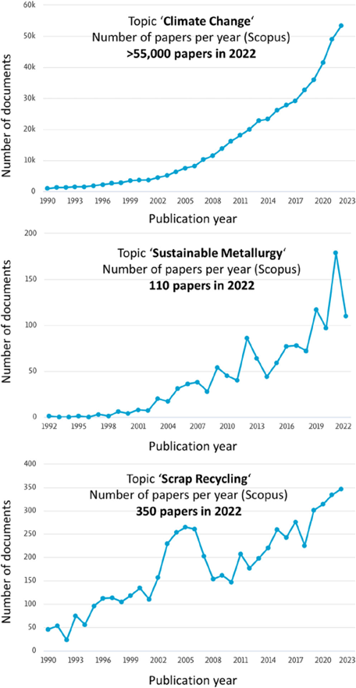
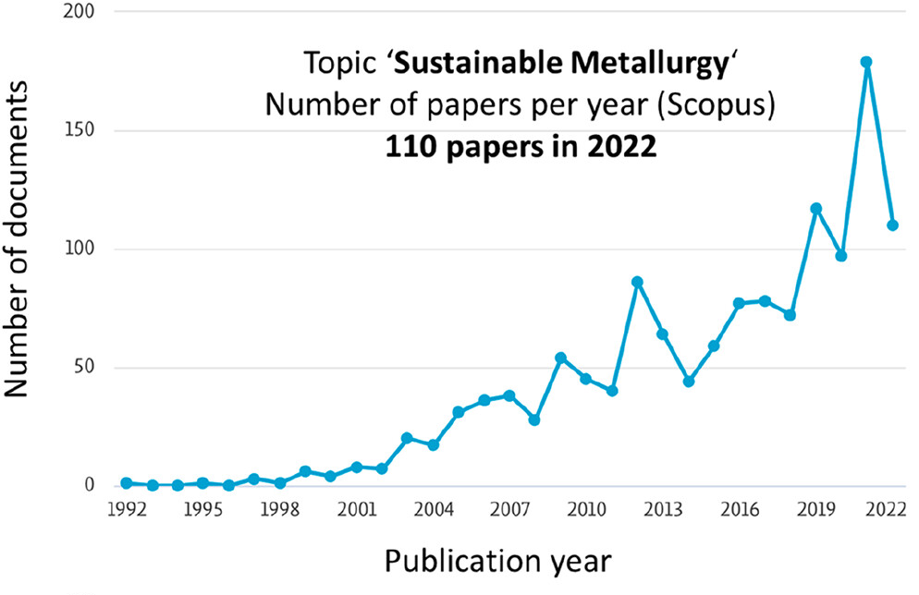
Why are we here?
After Dierke Raabe: Chem Rev 2023,123 2436-2608

Slide 3
Past
“Villains”

Slide 4
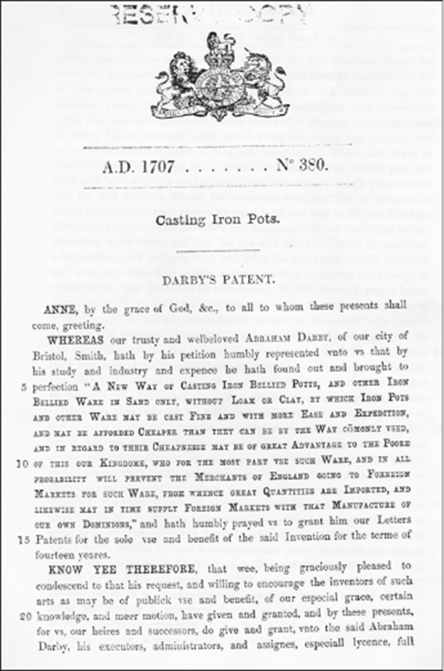
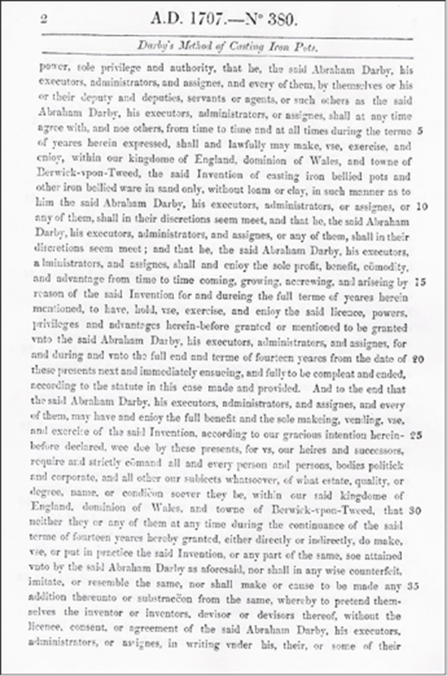
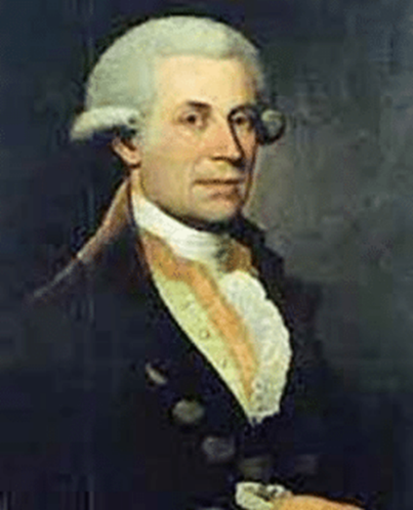
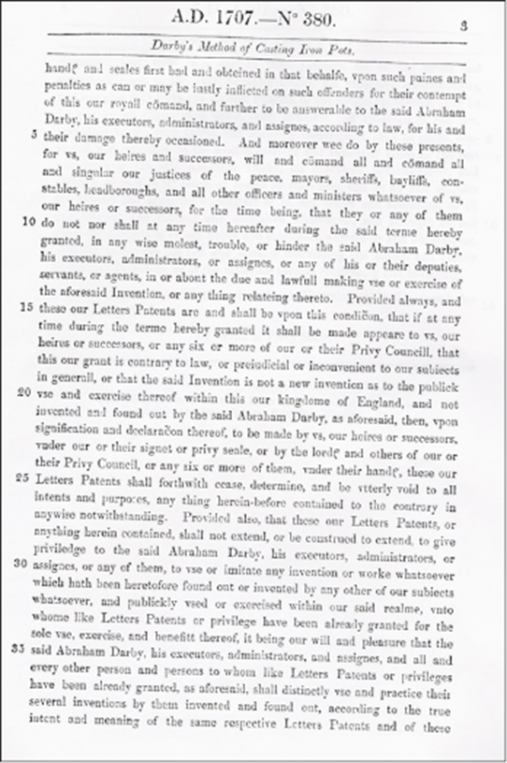
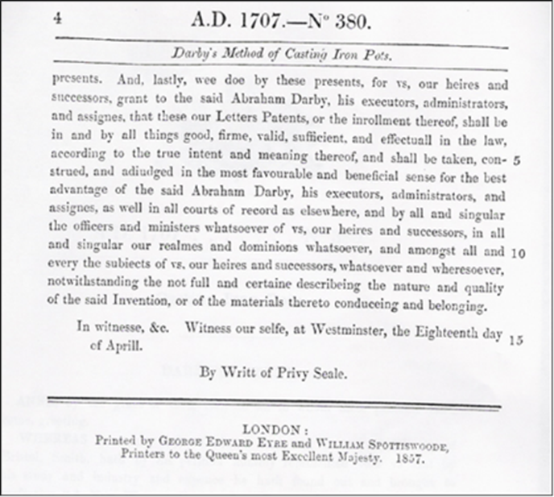
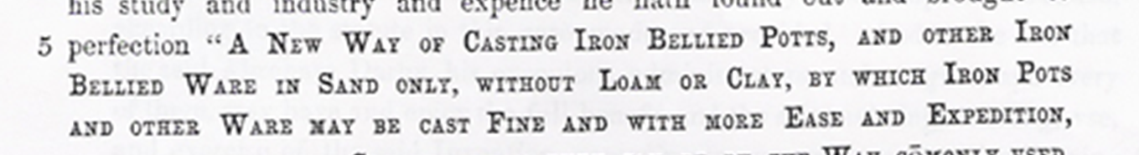
Abraham Darby I

Slide 5
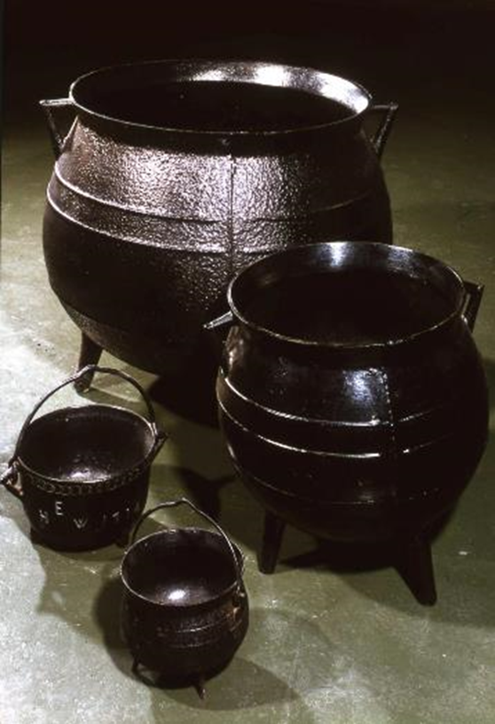
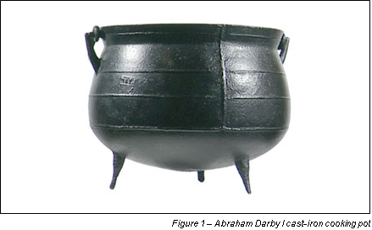
The Darby pot

Slide 6
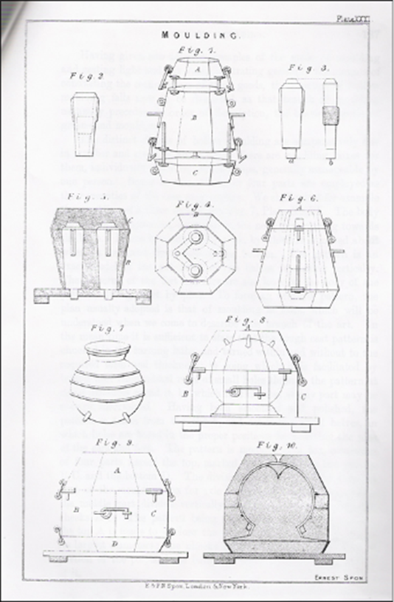

Runaway success
Notes:
Charcoal based iron making pre 1713 after success of the pot from 1707 patent Darby developed the coke fired blast furnace.

Slide 7
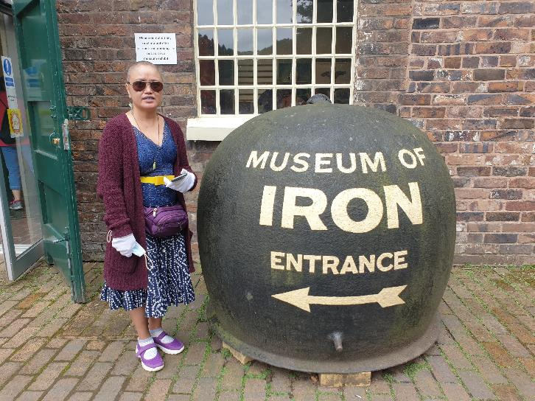
Even for whaling

Slide 8
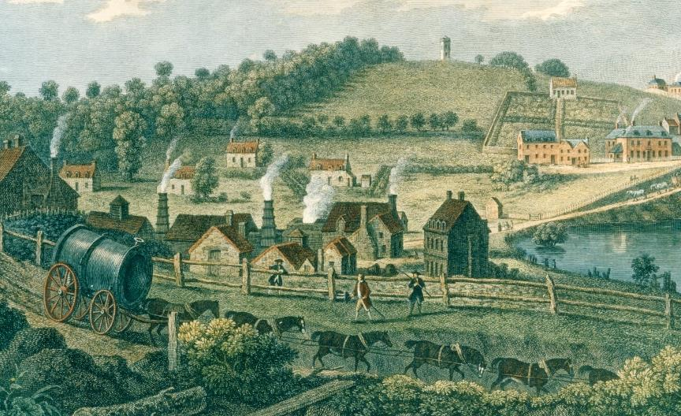
Coalbrookdale, 1750s

Slide 9
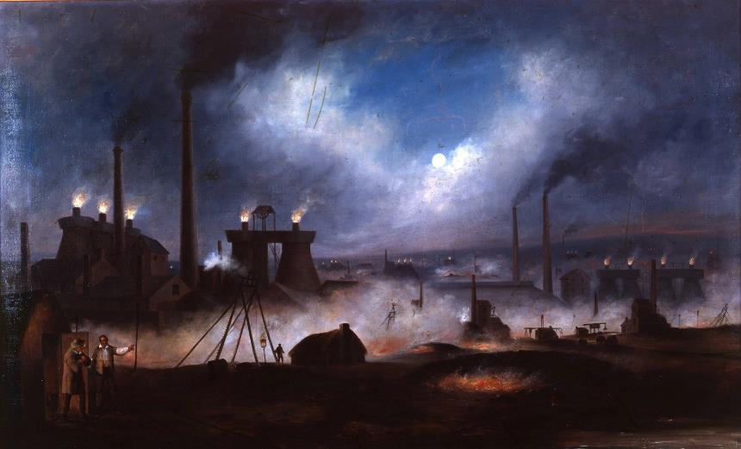
Wednesbury by night, 1850s

Slide 10
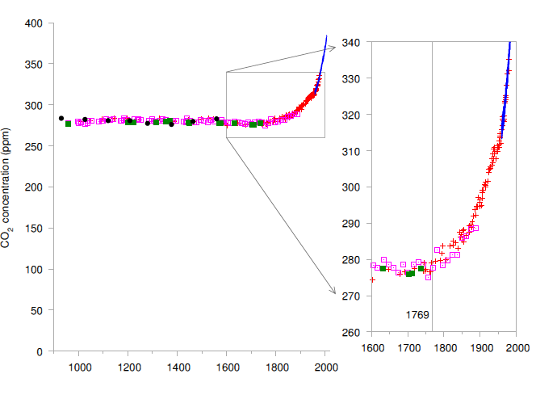
Climate Change
Increasing CO2 and other GHGs
“Sustainable Energy – without the hot air”, McKay

Slide 11
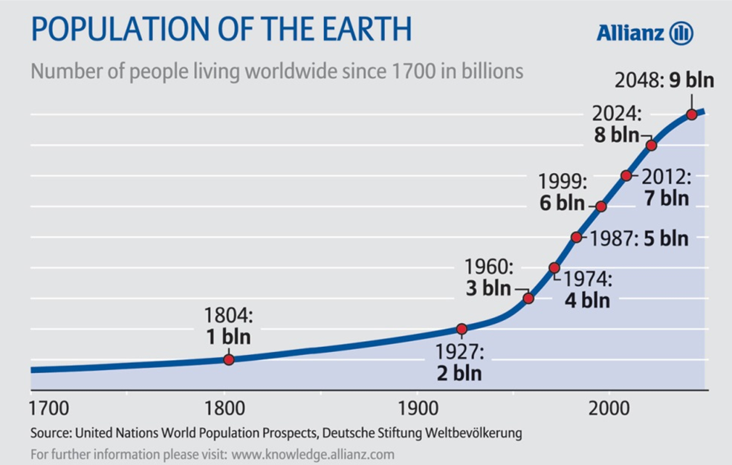
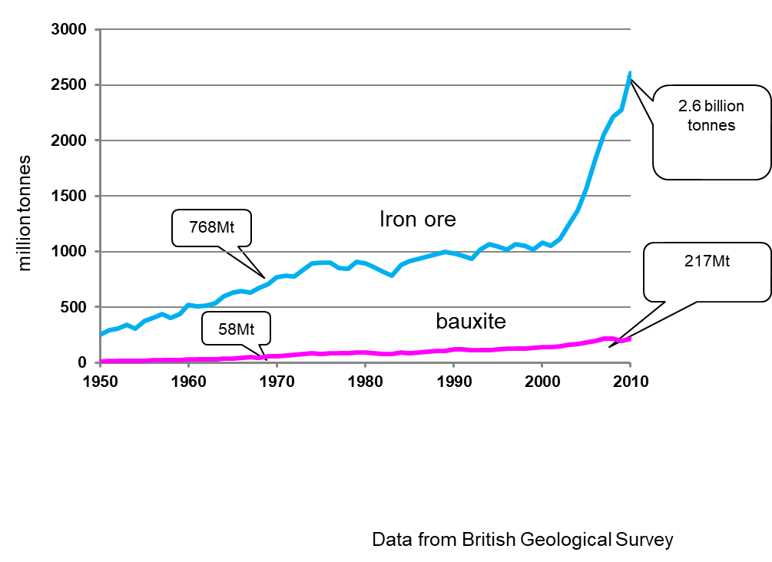
Increasing global demand for minerals

Slide 12
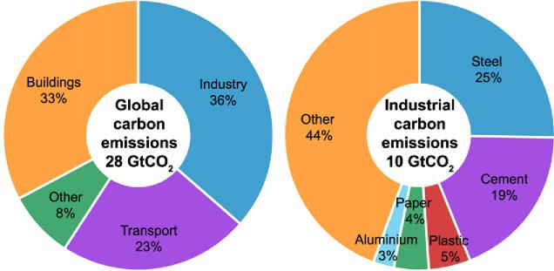
Breakdown of global CO2 emissions in 2006 demonstrating the importance of five key materials.

Slide 13
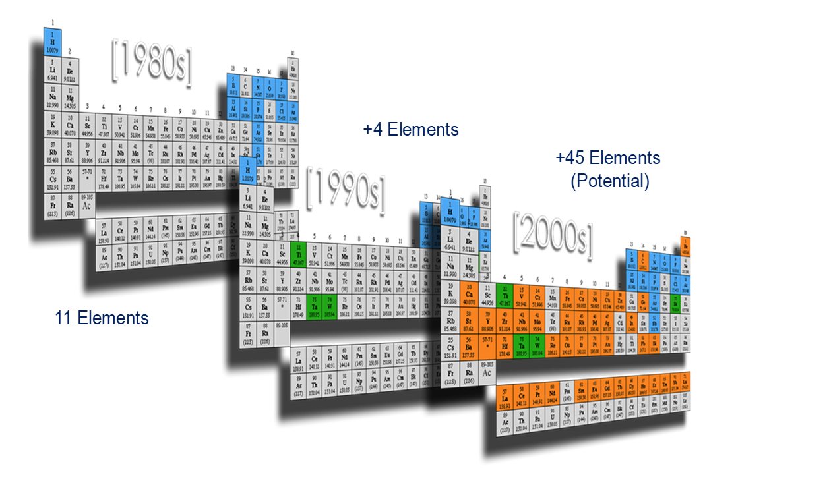
Growth of number of elements used in electronics
Source: T. McManus, Intel Corp., 2006

Slide 14
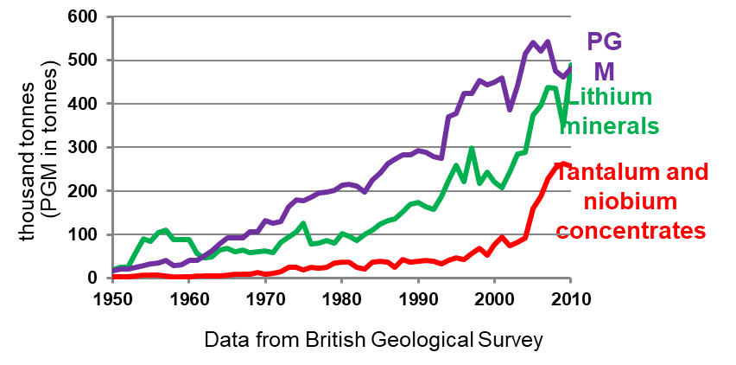
Growth of “technology” metals

Slide 15
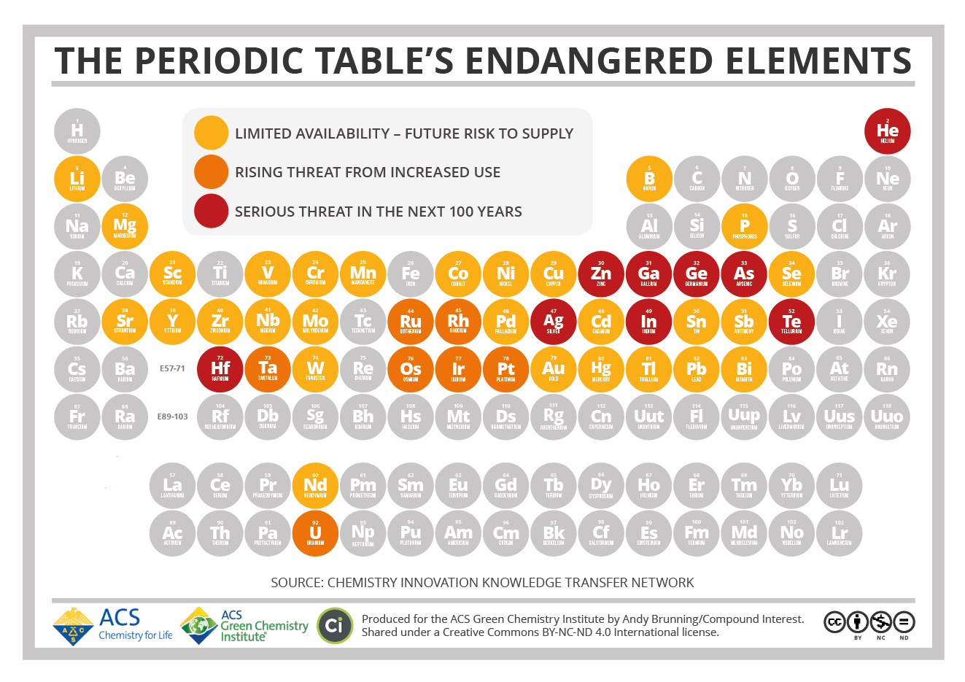

Slide 16
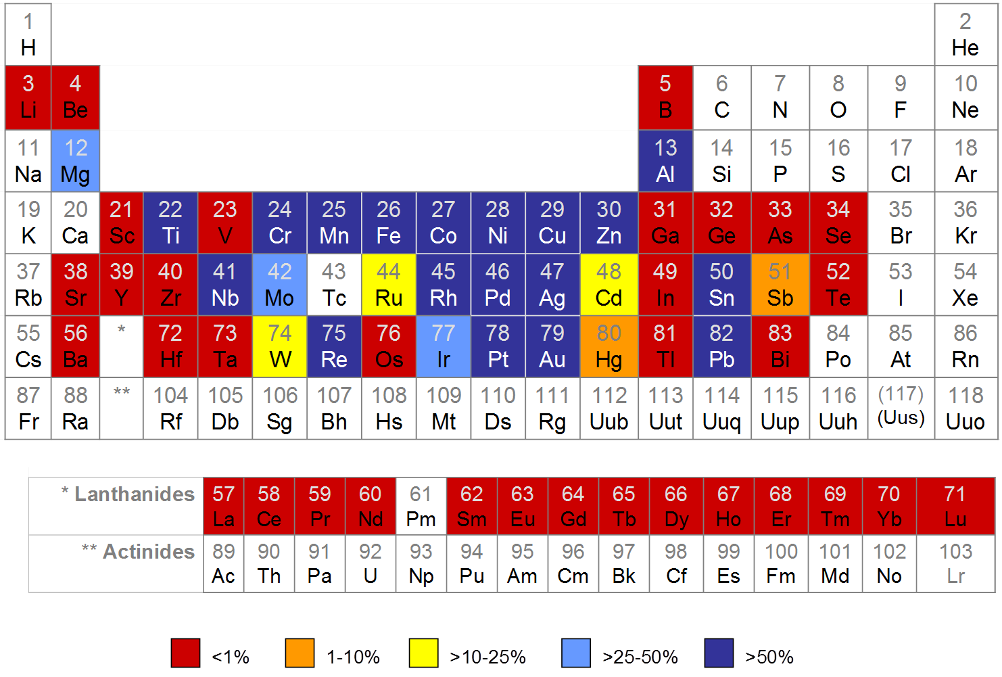

End of life recycling rates
> $5 M/tonne

Slide 17
Present

Slide 18
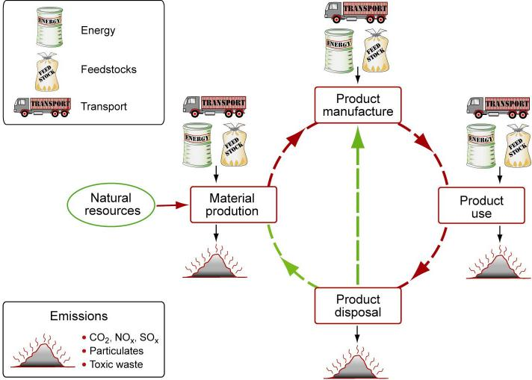
The materials/manufacturing cycle
Ashby et al. 2008: The CES EduPack Eco Audit Tool – A White Paper
Notes:
Extraction: mining, comminution, leaching, separation
Preparation: smelting/metal extraction, refining, alloying
Shaping: shape conversion processes
Reprocessing: recovery, recycling, reuse

Slide 19
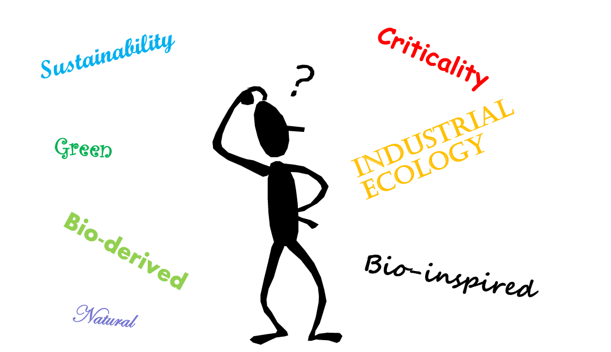
David Jesson, University of Surrey, UK

Slide 20
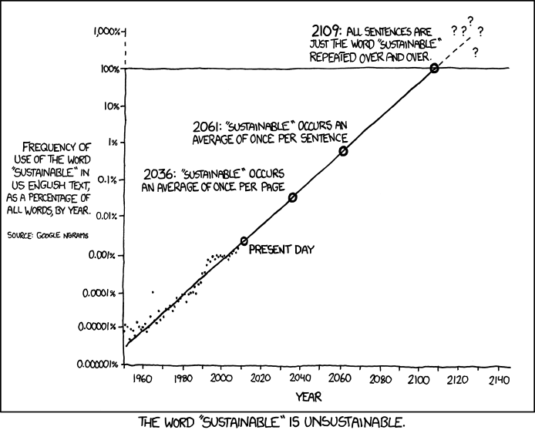
https://imgs.xkcd.com/comics/sustainable.png

Slide 21

https://imgs.xkcd.com/comics/sustainable.png

Slide 22
https://imgs.xkcd.com/comics/sustainable.png

Slide 23
https://imgs.xkcd.com/comics/sustainable.png

Slide 24
Processing and Manufacturing Issues
High energy in manufacturing (36% of energy usage)
Getting useful material from ore is energy intensive
4-6% world energy for comminution!
Liquid metal processing high energy & inefficient
Notes:
Getting useful material from ore is energy intensive
16% of CO2 from Steel and Cement peoduction
70 EJ/year for Steel and 20 EJ/year for aluminium
4-6% world energy for comminution!
High energy in manufacturing (36% of energy usage)
Liquid metal processing high energy & inefficient

Slide 25
Heat content of liquid engineering metals to 100 ºC > T_{m}
metal | solid |  | liquid |  | Melting point T_{m} | Latent heat of fusion L_{f} | Heat content by mass RT – Tm+100°C | Heat content by volume RT – Tm+100°C
 | density ρ_{s} | heat capacity c_{s} | density ρ_{l} | heat capacity c_{l}
 | (gcm⁻³) | (J.g⁻¹K⁻¹) | (gcm⁻³) | (J.g⁻¹K⁻¹) | (°C) | (J.g⁻¹) | (MJ.kg⁻¹) | (MJ.m⁻³)
Al | 2.7 | 0.917 | 2.4 | 1.080 | 660 | 397 | 1.092 | 2914
Cu | 9.0 | 0.386 | 8.0 | 0.495 | 1083 | 209 | 0.669 | 5942
Fe | 7.9 | 0.456 | 7.0 | 0.795 | 1536 | 247 | 1.018 | 7944
Mg | 1.7 | 1.038 | 1.6 | 1.360 | 650 | 349 | 1.139 | 1961
Zn | 7.1 | 0.394 | 6.6 | 0.481 | 420 | 112 | 0.318 | 2241
Pt | 21.9 | 0.130 | 19.0 | 0.178 | 1773 | 114 | 0.359 | 7855
Ge | 5.32 | 0.320 | 5.6 | 0.404 | 939 | 509 | 0.842 | 4477

Slide 26
Processing and Manufacturing Issues
High energy in manufacturing (36% of energy usage)
Getting useful material from ore is energy intensive
4-6% world energy for comminution!
Liquid metal processing high energy & inefficient
Yields - at the casting stage <50% at product ??
Cost pressure - low energy cost producers

Slide 27
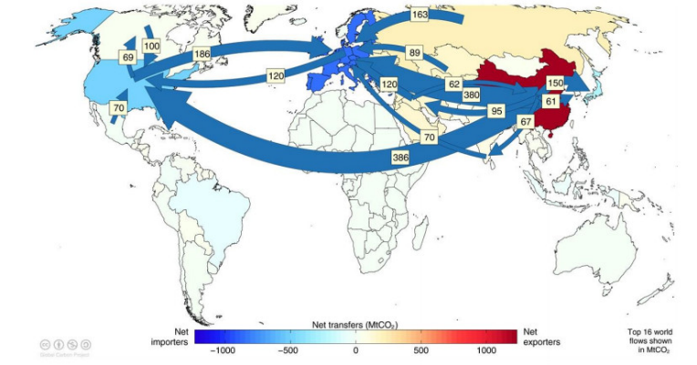
Offshoring our CO2
Why does it matter?
Incorrect measure of environmental impact in a product
Engineers don’t make right decisions
Doesn’t encourage local recycling
Hides true emissions per capita
Global flows of CO2
Notes:
Why does it matter?
So we have enough Steel and Aluminium scrap to significantly reduce our offshored CO2.
These are just 2 examples in the metals industry
Plastics
Technology metals

Slide 28
Processing and Manufacturing Issues
High energy in manufacturing (36% of energy usage)
Getting useful material from ore is energy intensive
4-6% world energy for comminution!
Liquid metal processing high energy & inefficient
Yields - at the casting stage <50% at product ??
Cost pressure - low energy cost producers
Philosophy of throwaway as only small amounts
                (mobile phones)
Export huge amounts of scrap engineering metal

Slide 29
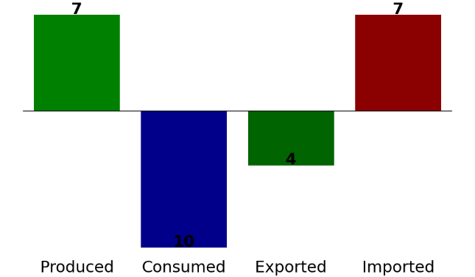
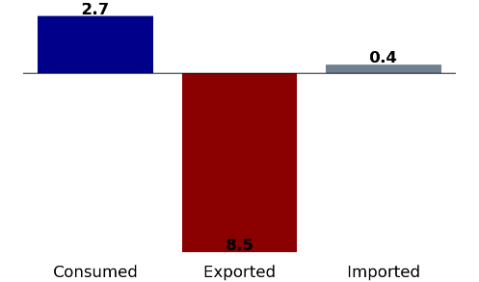
UK steel sector (2019)
Steel (Mt)
7.9
Scrap steel (Mt)
7.2
1.4 (2)
2.7
5.8 (1)
0.4
4.0
11.0
8.5
Produced Consumed Exported Imported
Consumed Exported Imported
Current production:
80 % Primary process 20 % Secondary process
Source: [1,2,3]
[1] BGS. United Kingdom Minerals Yearbook. BGS, 2021
[2] International Trade Administration. “Steel imports report: United Kingdom”. ITA, 2021.
[3] International Trade Administration. “Steel exports report: United Kingdom”. ITA, 2021.
Notes:
We've also looked at flow of raw materials into and out of the UK
Total usage in UK about 15 Mt - just over half is imported
We export 8.5 Mt scrap iron & steel
Similar story for Aluminium
https://www.trade.gov/media/9063

Slide 30
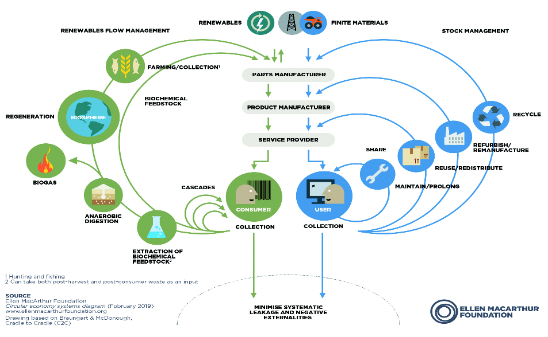
Changes to manufacturing: The Circular Economy
Notes:
I suspect most of us in the room have seen or at least heard of the Butterfly Diagram for materials and the Circular Economy.
First developed just over 10 years ago in a report from the Ellen MacArthur Foundation and McKinsey
compares a linear model
extract, move, use and dispose of more and more “stuff”
to different levels of circularity
we move outwards this represents more energy, and thus usually more CO2 and other emissions
move from
making products last longer by repair and maintenance,
reusing or repurposing,
remanufacture
eventually the highest energy level of recycling.
You’ve probably heard of LCAs Life Cycle Assessments –
which looks a bill of materials in a product and potentially all of the impacts during the lifetime of the product
Sometime however CE and LCA can be in conflict especially where the boundaries are difficult to define.
Product focussed
I want to take us out of product mode to materials. All manufacturing requires a material and most materials made are pretty basic.
For example cement 5 billon tonnes per annum globally leading to probably over 100 Billion tpa of concrete. Steel at about 2 B tpa globally – a large proportion of which goes into the concrete.
It is these materials that singularly contribute to a whole chunk of CO2 and other environmental hazards.

Slide 31
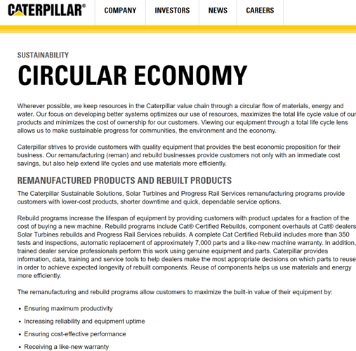
Changes to manufacturing: Remanufacturing
Caterpillar
  Remanufactured Engines
  Ensuring maximum productivity
  Increasing reliability and equipment uptime
  Ensuring cost-effective performance
  Receiving a like-new warranty
  Preserving the majority of energy and materials required to make the original component or machine

Slide 32
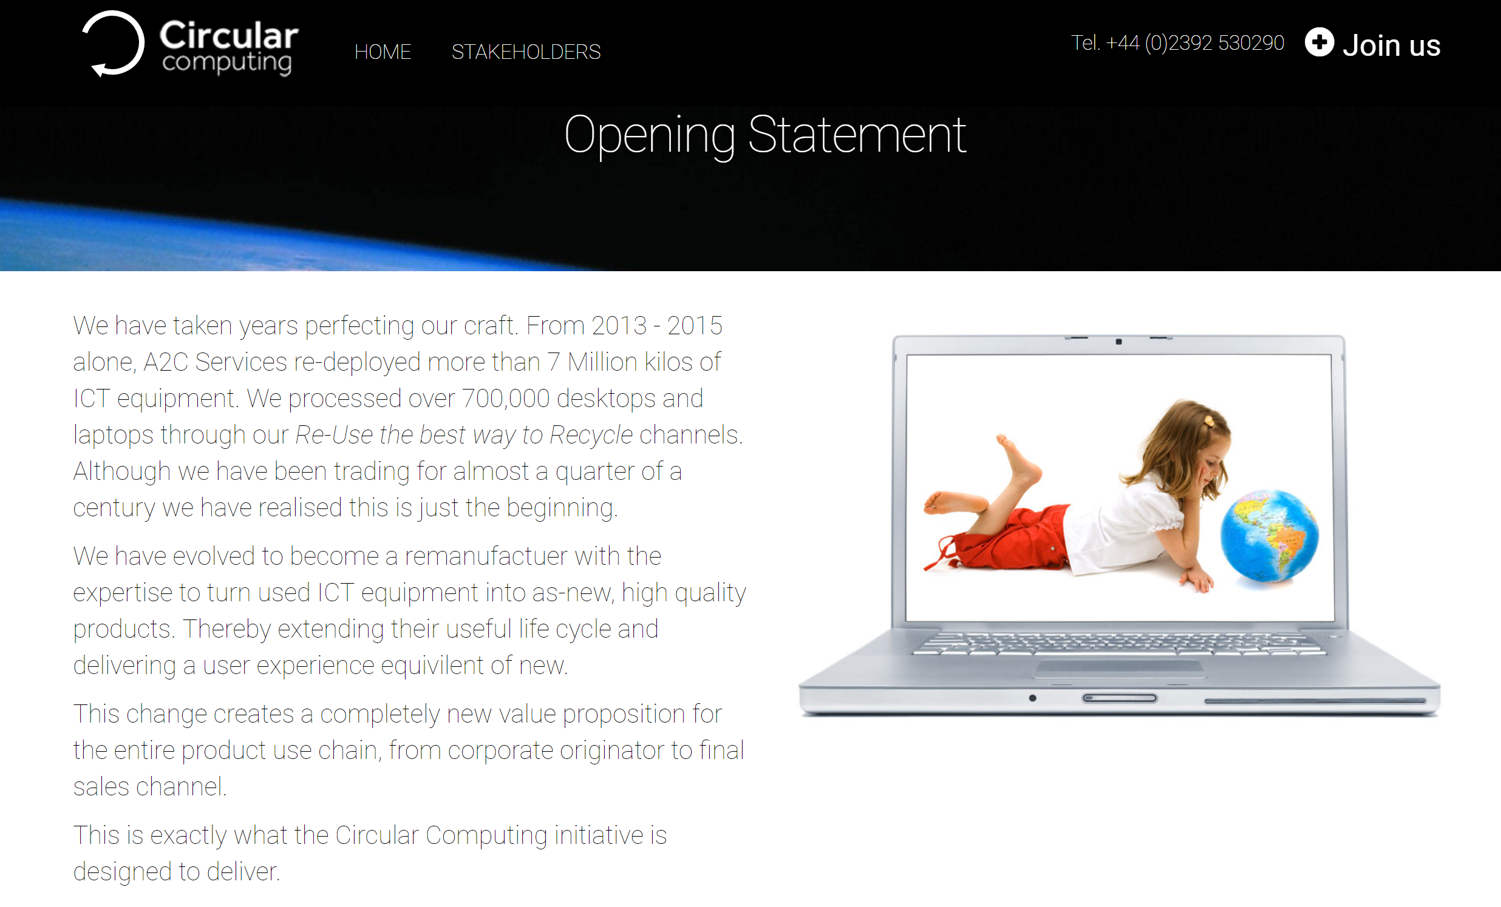
Changes to manufacturing: Remanufacturing
Caterpillar
  Remanufactured Engines
A2C
  Circular Computing
  Rebuilding laptops for large corporates
  Philosophy rebuild up to 4x!!
  No loss of performance
  5 trees planted offset CO2
  Support of Renewal Charity

Slide 33
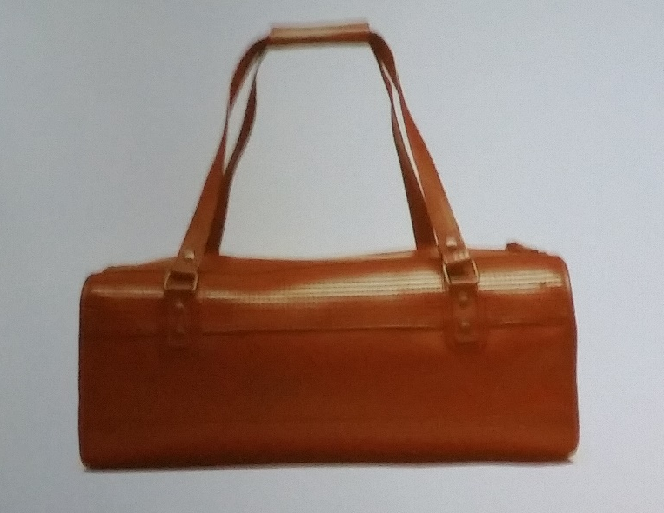
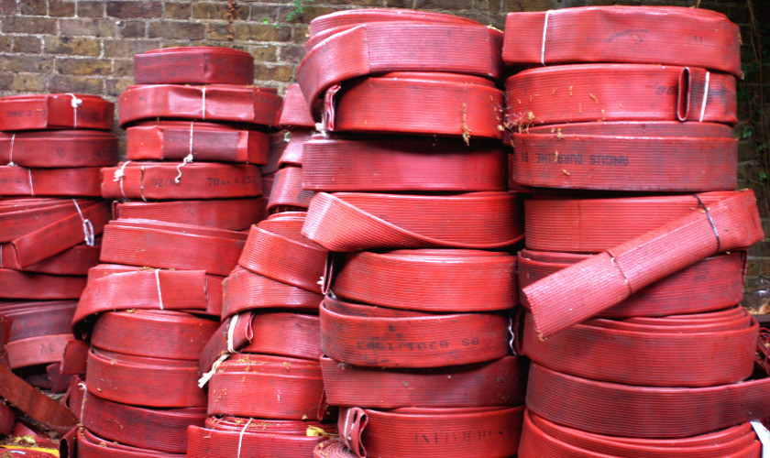
Changes to manufacturing: Re-using
Caterpillar
  Remanufactured Engines
A2C
  Circular Computing
Elvis & Kresse
  Handbags from hoses
  Parachute silk
  Rescue
  Transform
  Donate

Slide 34
Changes to manufacturing: Reshoring
Reduced length of supply chains
Developed world labour increasing costs
Automation – less reliance on labour
Quality
Redistributed manufacture
  Closer to customers reduction of product miles
Skills protection

Slide 35
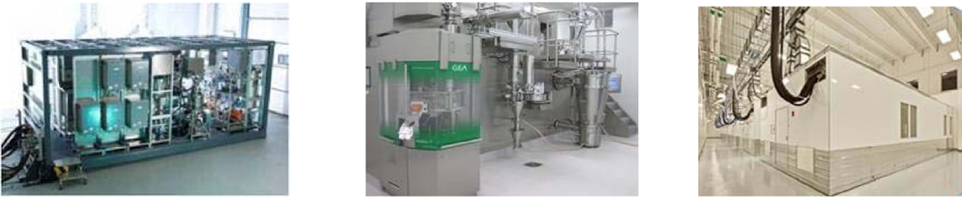
Changes to manufacturing:
Redistributed manufacture - drugs in a container!
Notes:
Technical
Certification & Legal
Supply chains
Economic models
Societal impact
Infrastructure

Slide 36
Changes to manufacturing:
Impact of redistributed manufacture
          Smaller more agile factories
            Use of new technologies (Additive Layer, Metal Injection Moulding)
          Reduce capital cost by 30% moving to continuous.
          Reduce footprint by 25%
          However to achieve this:
            Collaboration essential
            Linking academia and Industry to provide skills
            Technologies will be part of the shift into manufacturing being controlled by countries with best skills

Slide 37
Future

Slide 38
Future for sustainable manufacturing
Target
Developing know-how
Resource efficiency (Energy, meterials etc)
Increased recovery, re-use, re-cycling
Increase yields
Substitution
Decarbonisation of energy supply
difficulty

Slide 39
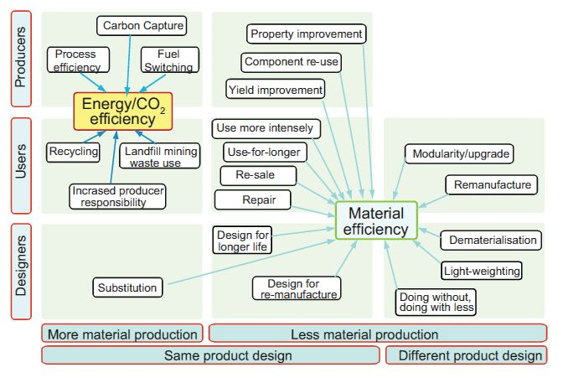
Actions for sustainable materials and manufacturing
Materials Efficiency: a white paper, Allwood et al., Resources, Conservation and Recycling, 2011

Slide 40
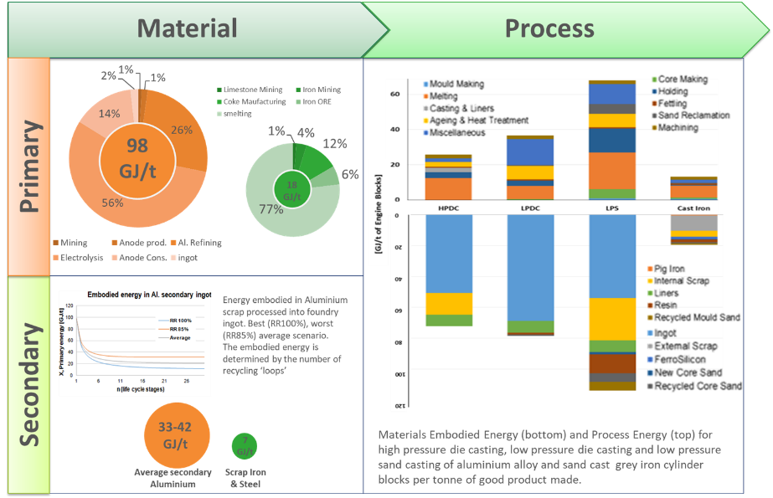
Beware light-weighting substitution
Notes:
A horror story of single line of thought from the automotive sector
Tail pipe emissions
Lightweighting
But is lightweighting actually lightweighting?

Slide 41
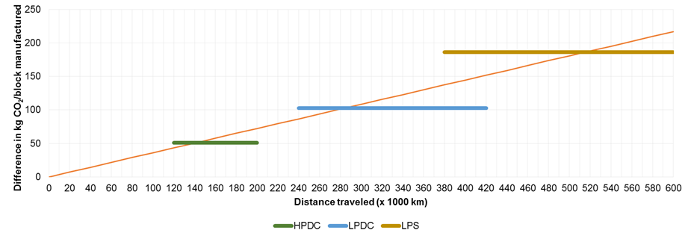
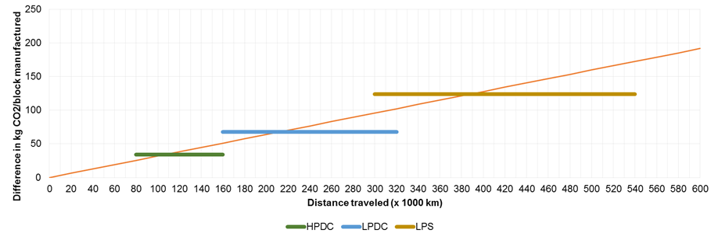
Distance to drive vehicle to pay back embodied CO2 and manufacturing CO2 in engines with Al cylinder blocks
Diesel
Petrol
Notes:
Behaviour driven by tail pipe emission legislation not total environmental impact
Legislation should incorporate
Embodied Carbon in materials
CO2 (and other) emissions in use phase
Other environmental impact
For example for every tonne of primary Al we create 2 tonnes of an environmentally hazardous waste called red mud pH 14 – has no use and no value

Slide 42
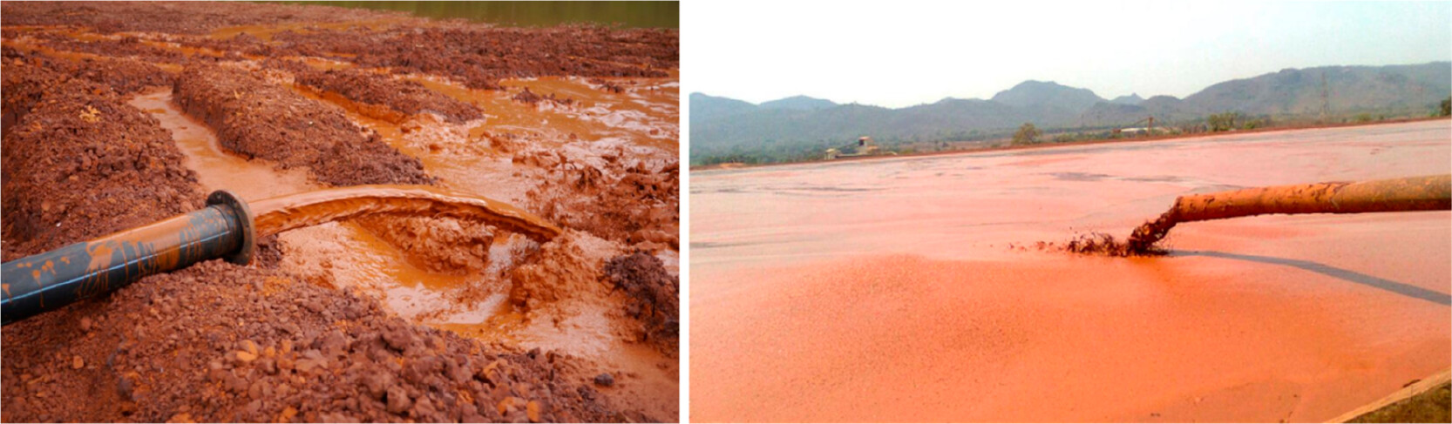
Environmental pollution of aluminium
Dierke Raabe: Chem Rev 2023,123 2436-2608
Notes:
View at typical red mud dump sites. Red mud is a bauxite residue, rich in iron oxide and titanium oxide as well as in a few rare earth metals. Bauxite serves as primary feedstock mineral for producing the alumina which is then used subsequently in fused-salt electrolysis to produce metallic aluminum. The red color comes from the high proportion of iron oxide compounds in the bauxite. In the context of developing re-mining opportunities, such dumped residues can become potentially commercially viable feedstock sources for future sustainable metallurgical production

Slide 43
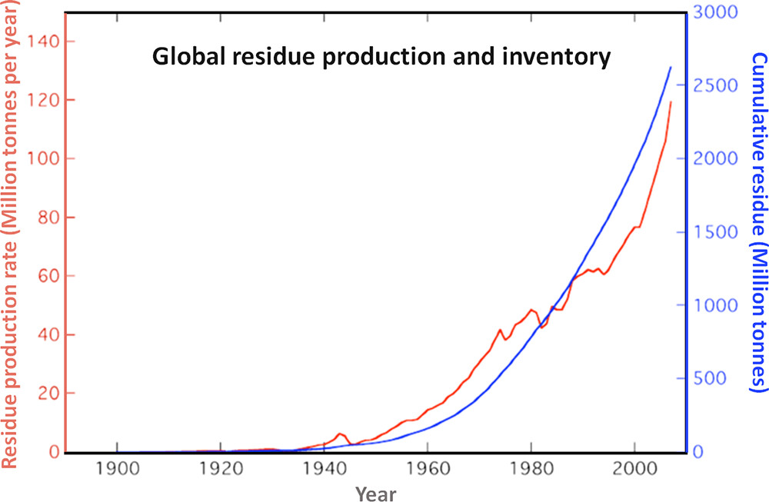
Cumulative red mud production!
Dierke Raabe: Chem Rev 2023,123 2436-2608

Slide 44
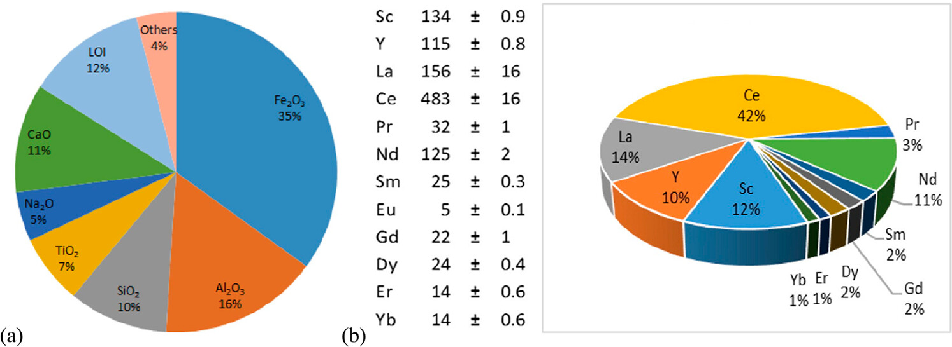
Composition of Red Mud
Dierke Raabe: Chem Rev 2023,123 2436-2608

Slide 45
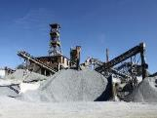
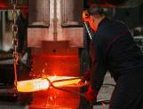
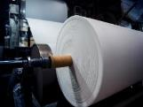
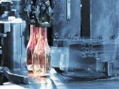
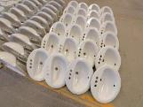
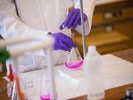
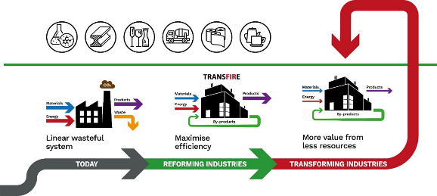
UKRI ISCF Challenge Transforming the Foundation Industries R & I Hub (TransFIRE)
75% of materials in the UK economy
Approx £50 Bn pa
10% of CO₂
Director: Mark Jolly
Deputy: Kostas Salonitis
Hub Mgr: Sanjoo Paddea
ED&I: Sue Black (Dur)
£10 M UKRI & Industry
3 years, 1st July 2021
12 ROs
>90 Companies
14 TAs & PEIs
Notes:
I’m running a programme as part of the Industrial Strategy Challenge Fund (as was) called Transforming the foundation Industries Research and Innovation Hub (TransFIRe). We are looking at the so-called foundation industries of
Cement
Ceramics
Chemicals
Glass
Metals
Paper
75% of all materials in the UK economy, £50 B
Helping the industries to get on the journey to net zero. Which I’ll talk a bit about later.
One of the work streams is looking a resource and energy flows for each sector and c then actually go down to the granularity or each company and process
We’re aiming to understand what the minimum resource required is for each measure of output – he is what we call Gentani
Resource inputs
Energy
Materials
Outputs
Useful output
By-products
Waste
Losses
High level per sector then becoming more granular to try to identify hotspots of energy or materials inefficiencies.

Slide 46
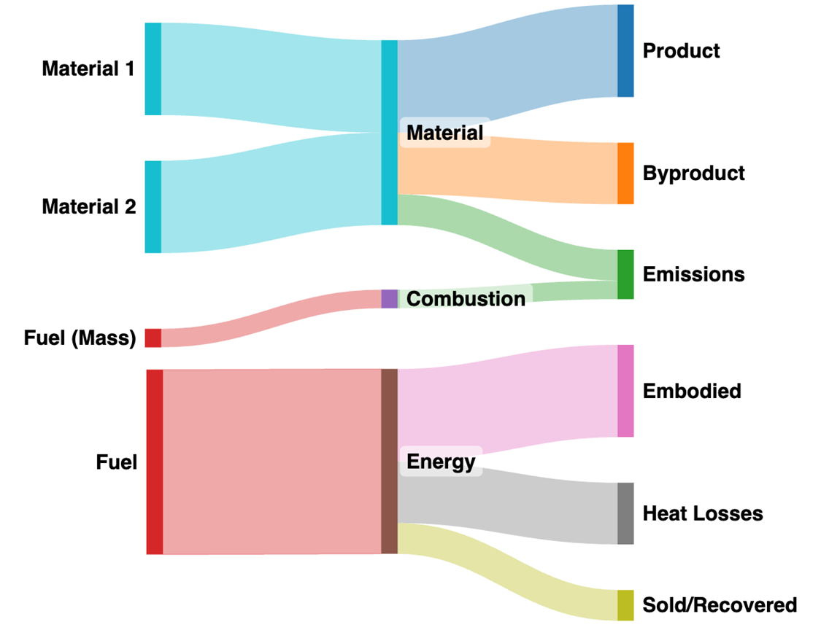

WS1 - Gentani
Achievements
Energy and material flow mapping for the 6 FIs
Process modelling and benchmarking (Gentani)
Validating current maps for the 6 FIs with the TWGs
Metrics
Next steps
Engage with companies to compare with benchmarks
Policy papers, webinars, parliament..
Critical minerals and materials
Notes:
In WS1, we have mapped energy and material flows for the 6 FIs.
From the Sankey diagram, we can obtain the main metrics, such as energy intensity and CO2 emissions per kg of product, which is an easy method to compare key performance metrics. We will look at some of these metrics a bit later
Next step is to consult with industry to validate these maps. We’ve started doing this via our Technical Working Group meetings.
The Cranfield team is looking at common FI processes and again reaching out to industry to obtain actual process values to compare with published data.
Anonymised for confidentiality reasons.

Slide 47
Output
Energy Intensity (MJ/kg_{product})
 | Cement | Ceramics | Chemicals | Glass | Metals | Paper
UK | 4.3 | 4 | 19.7 | 7.2 | 14.9 | 13
Global | 3.5 | 4.1 | 17.9 | 8 | 19.2 | 21
Difference (%) | 23 | 2.5 | 10 | 20 | 22 | 38
CO₂ Intensity (kgCO_{2e}/kg_{product})
 | Cement | Ceramics | Chemicals | Glass | Metals | Paper
UK | 0.85 | 0.25 | 0.97 | 0.51 | 1.29 | 0.83
Global | 0.80 | 0.32 | 1.35 | 0.57 | 1.47 | 1.45
Difference (%) | 6 | 22 | 28 | 10 | 12 | 42
Cement normalised by the unit of clinker
Notes:
Red colour is worse than the global average
Green colour is better than the global average
Cement is normalised by unit of clinker
Remark: Global average is a generous benchmark, if the country is considering to be leading towards net-zero an ambitious target is look against the best practices for each sector
Here we present the energy intensity benchmark
- Cement and chemical sector are more energy intensive than the global average. However, the value reported for chemicals has a high uncertainty associated.
- In none of the sectors the UK is performing at the best practice levels, it implies that are room for improvement if we are envisioning to be leading the pathway to net zero.

Slide 48
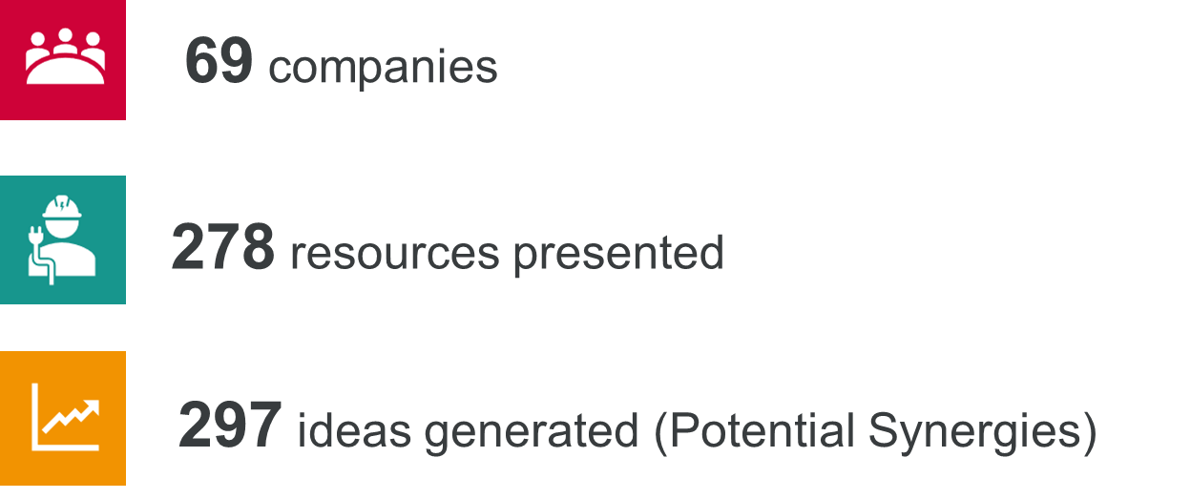
WS2 – Where there’s muck there’s brass
Achievements
Industrial symbiosis workshops
New products from waste streams
Alternative raw materials
Next steps
3rd Industrial Symbiosis workshop
New products from waste streams
Collect economic data
Short projects
eBay of waste?
Notes:
great success with our Industrial symbiosis workshops facilitated by International Synergies
Outputs from 1st & 2nd workshops combined as shown on screen as example
a number of new products from waste streams for example composite footwear for Texon, a thermoset coating for AkzoNobel
In glass, the team has also looked at alternative raw materials in order to reduce the melting temperature
We would like to run a 3rd and final industrial symbiosis workshop as part of the FI forum in October.
Continue to look at new products from waste stream for example fairly recently we’ve been approached by Saint Gobain to look at glass wool into concrete
What is really important is we look at the economics of some of these facilitated symbioses, is it actually financially viable? What about those waste that’s not going to landfill anymore, can we quantify this economically?
In parallel, the team will be seeking to develop short-term projects with industry and further enhance the engagement with industry and business partners with a view to generate more multi-disciplinary projects.

Slide 49

WS3 – Working with communities
Achievements
Case studies of opportunities/obstacles in community use of waste heat
Mapping of partner sites and resource co-location
Review of metrics for the FIs which look “beyond the fence”
Applying “User Journey” methodology within firms/sectors
Next steps
Alvance case study
Complete sectoral reports
Develop a Business Models output
Notes:
WS3 case studies of opportunities/obstacles in community use of waste heat from FIs.
case studies in these industries show that there are often the same obstacles to its use. The reasons are sometimes simply financial or geographical (if the FI is very remote). But contract design, lack of trust, and lack of targeted incentives are also significant contributors – as revealed by looking at the few successful examples.
WS3 research is also examining other partners who can contribute to the uptake of waste heat in FI localities, including the Coal Authority and water companies (both of whom have water-based heat to commercialise).
Work with WS2 uses GIS techniques to spatially identify partner sites and to map patterns of resource co-location – for example, by-products that other FIs can use. GIS allows mapping to show both geographical locations and journey-time proximity.
WS3 has completed a review of metrics for the FIs which look not just at plant/company performance but more holistically to include “beyond the fence” impacts. These metrics draw on the internationally recognised SD goals.
The “User Journey” method is a form of moderated focus group, aimed at helping actors identify where they wish to head and what the likely obstacles and opportunities are. It was developed for community environmental development objectives but WS3 has applied it to FIs, with examples undertaken with individual firms (Zentia) and within sectors (container glass).
Next steps: Alvance case study examines a relatively remote and isolated FI with abundant waste heat. The focus is on developing initiatives in conjunction with local planners and community groups in light of current house-building, HE-sector developments and NHS expansions.
Complete academic papers (currently in draft) and policy summaries based on User Journey studies and on FI case-studies undertaken.
For the Foundation Industries Forum (and for wider use) develop a Business Models presentation which examines the motivations for and barriers against the incorporation/adoption of sustainability/circularity principles into FI operations

Slide 50

Energy losses in metallurgical industries
Dierke Raabe: Chem Rev 2023,123 2436-2608

Slide 51


Equity, Diversity & Inclusion (EDI)
Achievements
EDI strategy
EDI Working group
Report on state of EDI in UK FIs
Landscape map
Case studies (Transforming workplace culture & Elevating wellbeing)
Site visits (16 to-date)
Playbook
Notes:
We have prepared an EDI strategy for the FIs which has been circulated to all our industry partners.
We’ve set up an EDI working group which meets on a monthly basis. The group brings together expertise from across the FIs on the topic of EDI (for example Helen Rose from Encirc, Kirstie Lamb from Constellium and so on). It is responsible to identify opportunities for learning and collaboration and support delivery of our strategic action plan.
The TransFIRe EDI team have brought together a series of findings in a “State of Equity, Diversity and Inclusion in the UK Foundation Industries 2022” report which also includes results from our EDI survey.
The purpose of the site visits is to capture EDI maturity, EDI needs, and inform materials for the EDI Playbook. Over 15 EDI Visits have now been carried out. EDI Landscape map identifies existing EDI related activities and programmes within the foundation industries, and relevant case studies from other sectors.
The EDI Playbook is a work in progress, continually growing set of resources and case studies to support organisations within the foundation industries to increase equity, diversity and inclusion in their teams.
-On the topic of ‘Race and social class’, our initial aim was to conduct analogous research to that conducted by UKRI of gender and age in the FIs. However, data collection of these demographics has been found to be scarce amongst FI organisations, so we have moved focus to study organisations’ ethnic/racial and socio-economic diversity based on information shared publicly such as on their website and social media.
All of the above are available to download from our website
Next steps:
Aiming for a few more site visits to get good representation. We have a goal to visit small, medium, and large sized businesses in each of the foundation industries. The final output of this work will be a report that consolidates findings across these businesses.
For the playbook which is a work in progress, we will continue to work with TransFIRe industry partners and subject matter experts across the UK foundation industries to compile data, best practices, insights, resources and strategies, to create this shared knowledge-base.

Slide 52

Technology – digital solutions
Process control
Materials passports
AI for functionality over purity
Sustainability assessments in design
Notes:
Technological progress forms a crucial part of transforming foundation industries. Here highlighted are digital solutions for:
Improved process control for example to enable Gentani
Tracking materials, components and products, with information brought together in product passports which help to assure quality of 1) Reused products and components and 2) Recycled materials
Enable instant assessment of materials, facilitating a radical move away from a focus on material’s purity and instead focus on functionality
Enable rapid holistic sustainability assessments covering environmental, social, technical and economic aspects

Slide 53

Decarbonisation of energy supply

Slide 54

The rebound effect
Dierke Raabe: Chem Rev 2023,123 2436-2608
Notes:
Rebound effect in terms of the over-proportional use of metals (produced with the current CO2 footprint) for realizing sustainable technologies. (a) Specific example of material usage for a 3 MW wind power plant. (b) Use of critical elements (with high CO2 footprint) required for manufacturing and erecting various types of sustainable technologies.

Slide 55

Material consumption & CO2 emissions of energy sources
Dierke Raabe: Chem Rev 2023,123 2436-2608
Notes:
Rebound effect in the metallurgical sector for the case of power generation. For significantly reducing the greenhouse gas emissions from power generation a transition from conventional fossil-fired power plants to sustainable power generation technologies must be realized (particularly wind and solar). However, these latter technologies are much more material-intense than conventional fossil-fueled power plants. Since all the metals (and other materials) required for low-carbon power generation are produced by using the currently existing CO2-intense mining and production methods, the introduction of sustainable power generation will not lead to a reduction but instead to a temporary increase in greenhouse gas emissions.

Slide 56

The rebound effect
Dierke Raabe: Chem Rev 2023,123 2436-2608
Notes:
Origin of the rebound effect in the metallurgical sector:
using sustainable technologies will be beneficial on the long run for the environment, but manufacturing these technologies with metals that are produced by the currently used CO2-intense technologies is not. The figure shows the intensity of material use for different technologies, revealing that a high amount of steel is needed for all of them.

Slide 57


OECD forecast of consumption of raw materials
Dierke Raabe: Chem Rev 2023,123 2436-2608
Notes:
An OECD forecast suggests that consumption of most raw materials will double by 2060. This means that the metallurgical (and generally the materials) sector cannot be exclusively built on circular economy principles, simply because there is not enough scrap and waste material available to fuel this strong market growth during the next decades (in which massive reduction in CO2 emissions is particularly critical). Therefore, sustainability measures must be identified, researched, and implemented which encompass all facets of the currently prevalent linear production, i.e. the primary metallurgical synthesis with its huge greenhouse gas emissions. (5)
Changes in the amounts of metals produced over the last decades, with growth rates exceeding in part 300%. OECD: Organization for Economic Co-operation and Development.

Slide 58

From reforming to transforming
Notes:
Before going into our strategy and results, what do we consider transformative change?
Move away from linear production and consumption systems.
Reform industries 1) by minimising resource use in manufacturing processes and 2) through industrial symbiosis in which wastes and by-products from industry are used as raw materials. These are mostly technical changes that can substantially improve the current models of production. The key question in reforming industries is: how can we reduce impact of current production models?
For sustainability, to regenerate the environment, resource use at a whole system level must be reduced. Transformation is about rethinking production and consumption models, more fundamentally asking: why are we producing and consuming in this way? can our needs be met with less resources while generating more value for people, environment and economy?

Slide 59

Notes:
Even in a best-case scenario─by the year 2060─only two-thirds of the greenhouse-gas-intensive mass market for metals (iron, aluminum, nickel, titanium) will be circular in average and at least one-third will remain linear (i.e., based on mining, refining and primary reduction) for several decades to come. This means that─simply due to high demand growth─at least one-third of the metal mass markets will also in the future have to be provided by primary synthesis, which creates massive greenhouse gas emissions. Today the situation is actually opposite when viewed at a global average; i.e., only about one-third of the total metal mass market is served from circular production (through melting scrap) while two-thirds are linear, coming from newly mined feedstock. This huge fraction of primary synthesis is the biggest single source of global warming and must therefore be addressed by research with high priority. The figure also refers to a few other high-leverage measures for increasing the sustainability of the metallurgical sector.

Slide 60


Slide 61


Slide 62

The age of sustainability and circular economy
Dierke Raabe: Chem Rev 2023,123 2436-2608
Notes:
The dawning age of sustainability and a circular economy and the roles materials play in it: After more than 5000 years the materials sector must be decarburized, electrified with renewable energy and turned toward higher scrap use. This is nothing less than a revolution which must be accomplished in less than a few decades.

Slide 63
Recycling “circular” economy
Production and consumption patterns largely unchanged
Reformative
Technology will save us
Resource efficiency
Progress = Green growth
Weak sustainability
Sustainable circularity
Halve average material use p.p.
Transformative
Behaviour change + technological innovation
Resource sufficiency + efficiency
Progress = Well-being and environmental quality, with economic prosperity
Strong sustainability
Recycling ≠ Circular economy
Notes:
This change in focus from reforming to transforming is similar to the step-change visible in the circular economy community
Growing recognition that a circular economy focused only on re-jigging resource flows within the confines of the current political-economic model cannot deliver on sustainability.
For example, green growth relies on decoupling of resource use from GDP growth, but scientific evidence demonstrates that decoupling is not happening sufficiently and not fast enough, meaning that green growth has been strongly debunked & meaning that a growing part of the circular economy community is looking to enable deeper transformative changes.

Slide 64
Key messages
Don’t legislate on one measurement!
Measure all environmental impacts, calculate social value
Move away from linear thinking to systems thinking
Move from economic models to value models
Become more localised in materials flows
Technology will not achieve net zero: need to reduce consumption
Reduced consumption must lead to different value models
Different value models may need to use digital technologies
Different value models may require social change

Slide 65

Social Media
@Cranfield_MFG
@TransFIReHub
@MarkRJolly
@CranfieldUni

